Slide 1
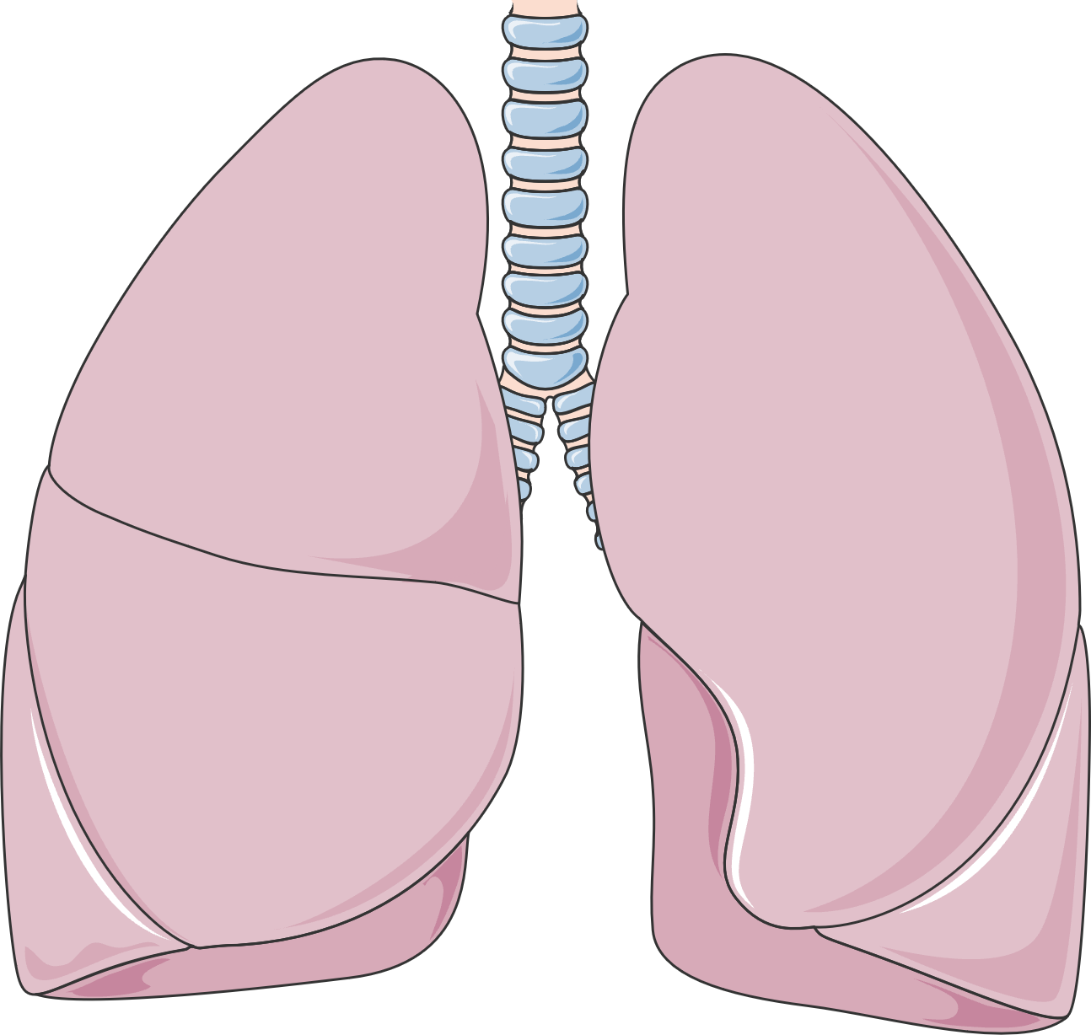
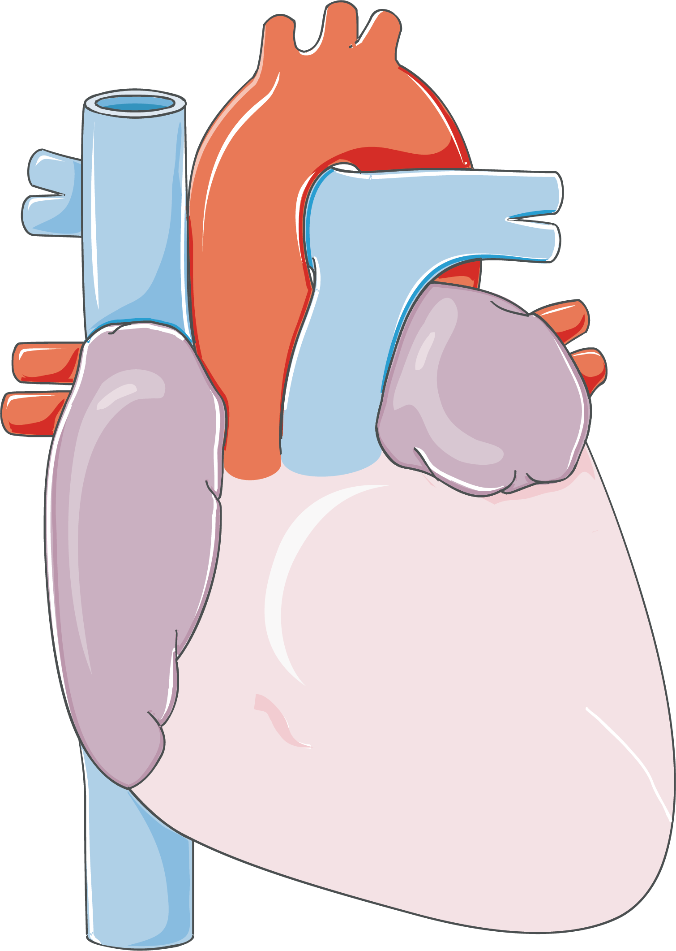
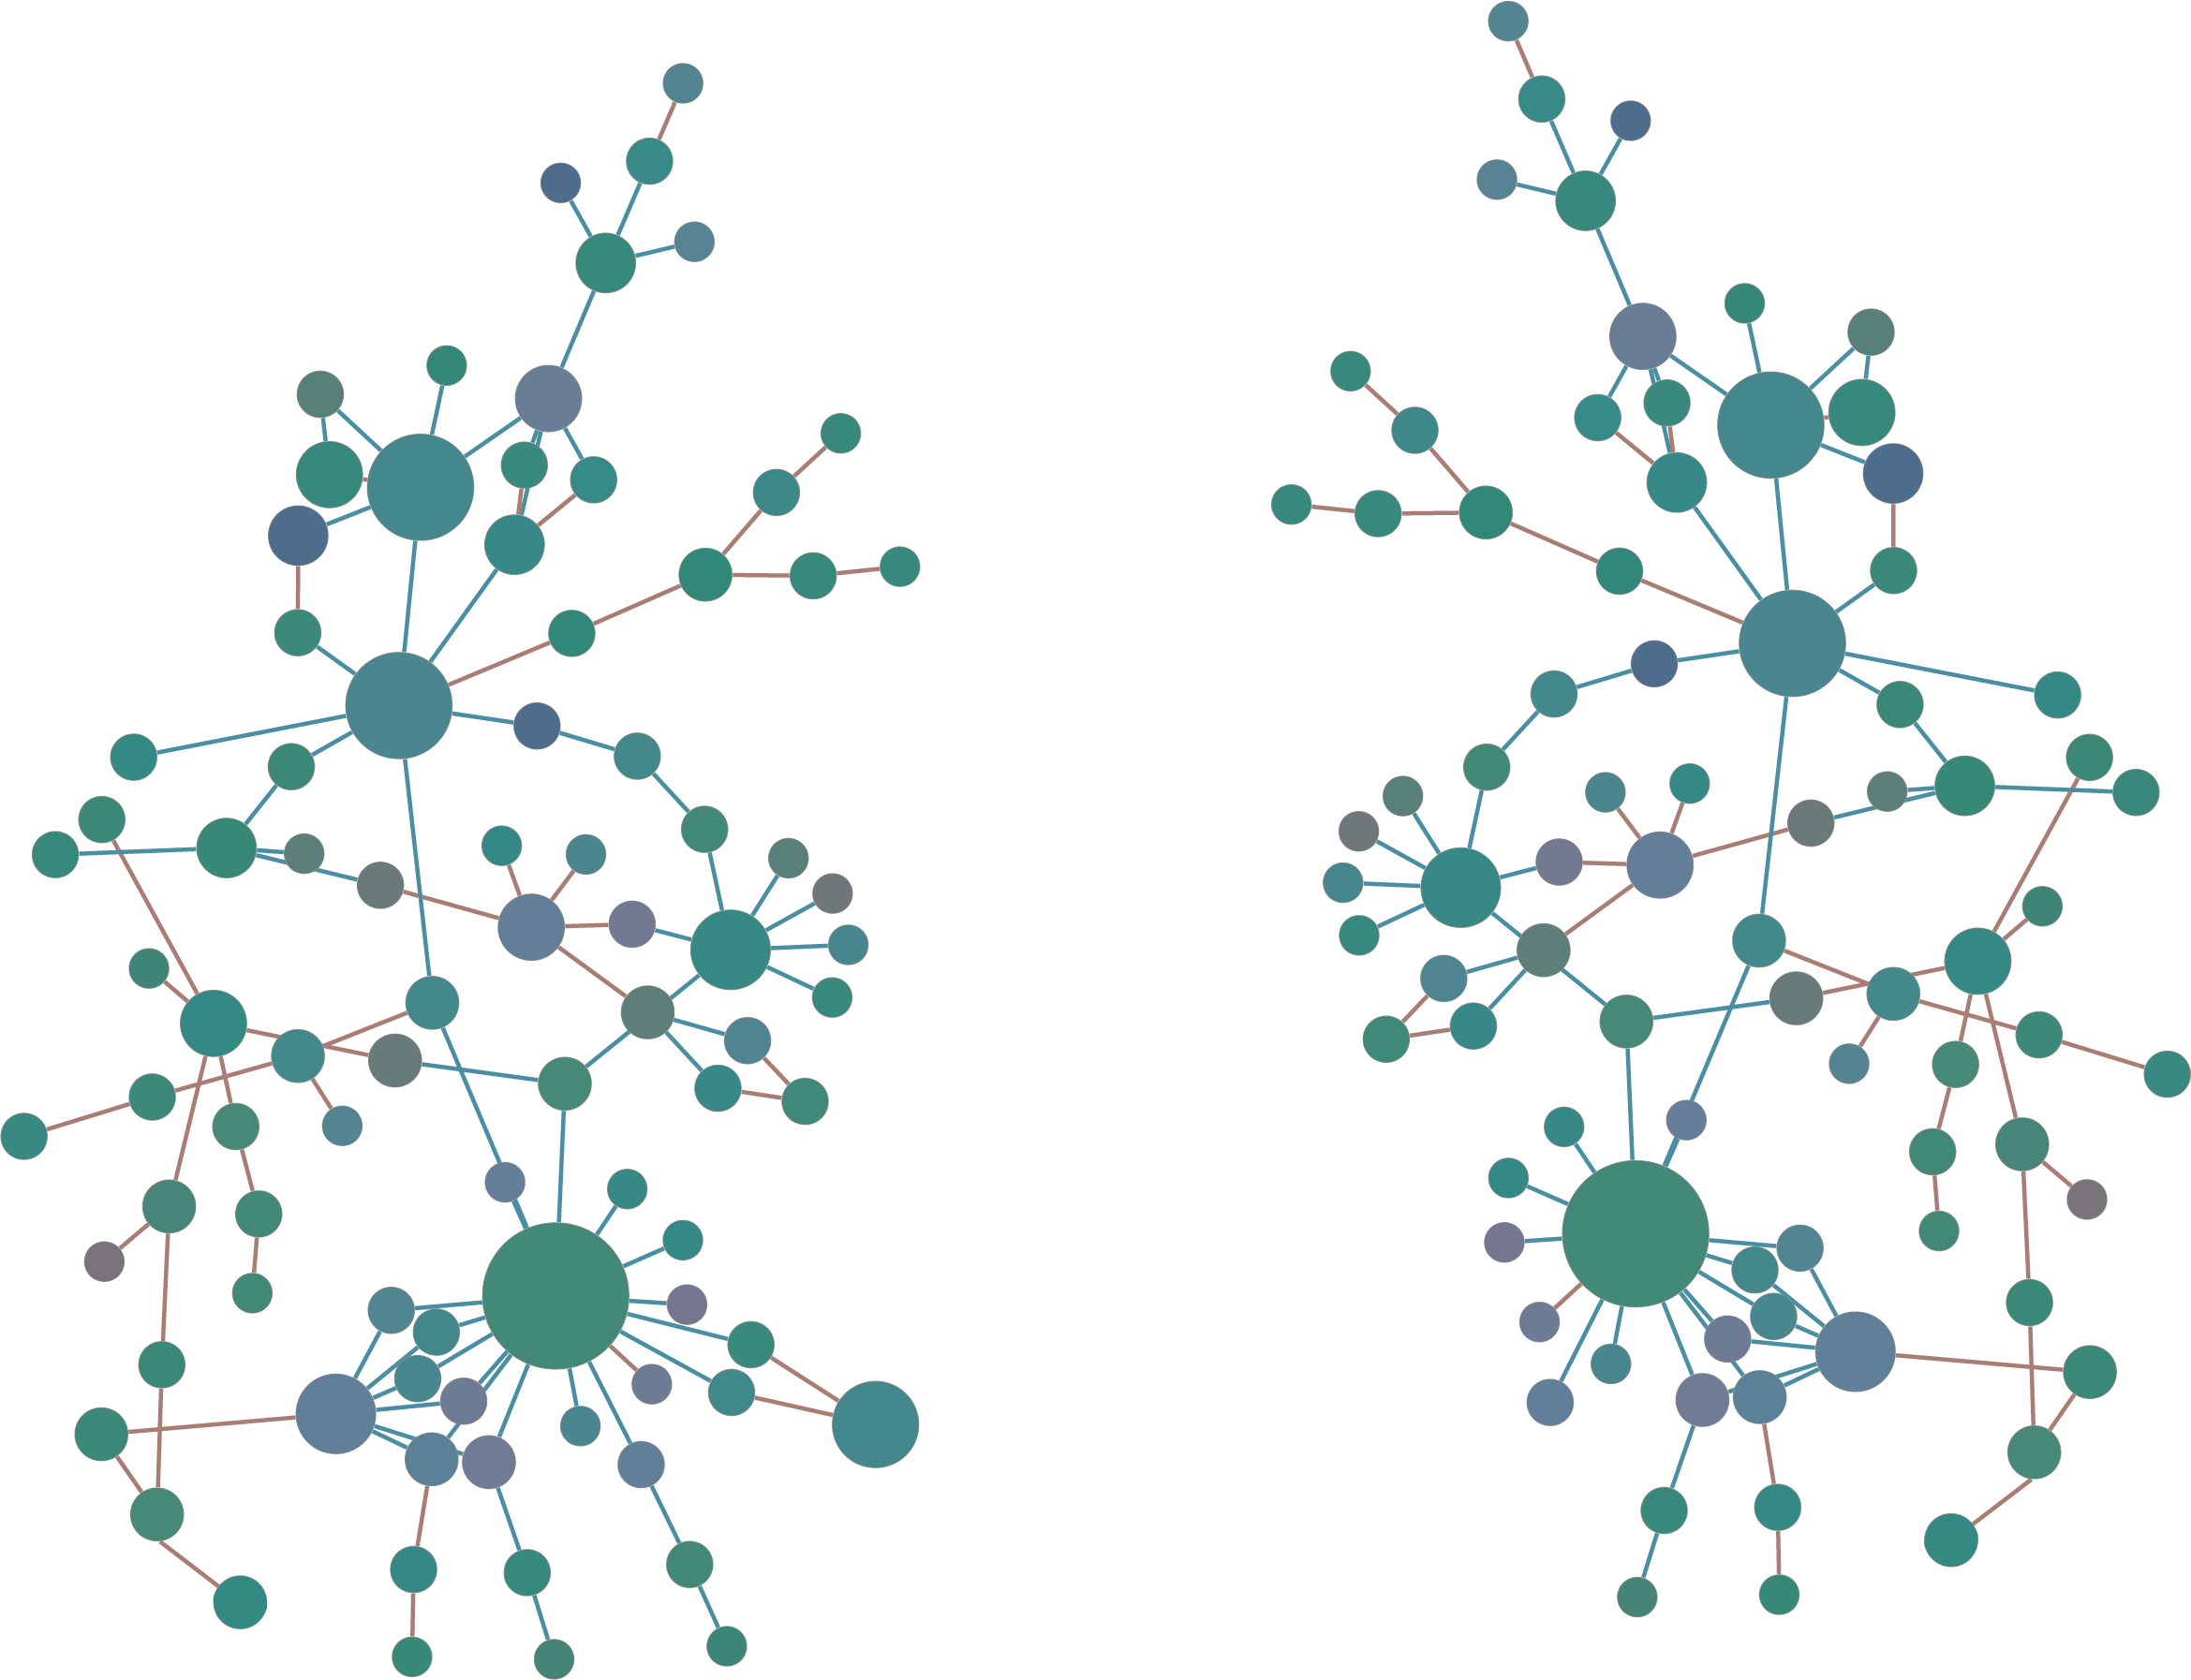
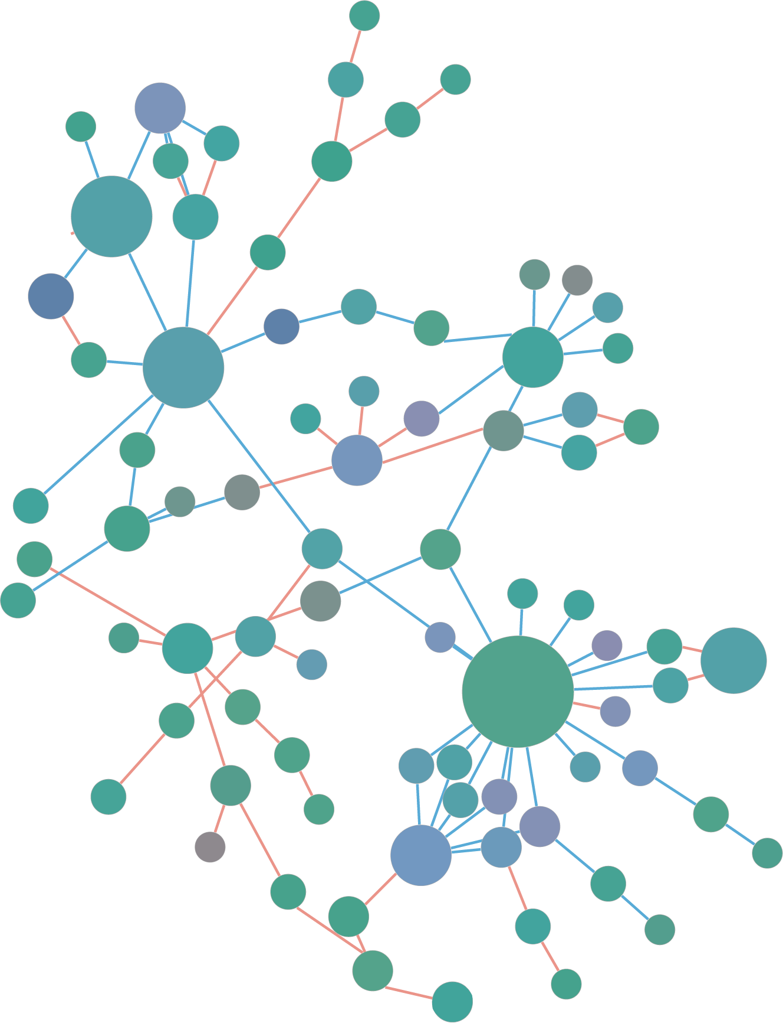
2022 Summer Internship Introduction
Dr. Muhammad Arif
Postdoctoral Visiting Fellow
Section on Fibrotic Disorders
Laboratory of Cardiovascular Physiology & Tissue Injury
National Institute on Alcohol Abuse and Alcoholism
National Institutes of Health, MD, USA

Slide 2
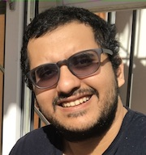
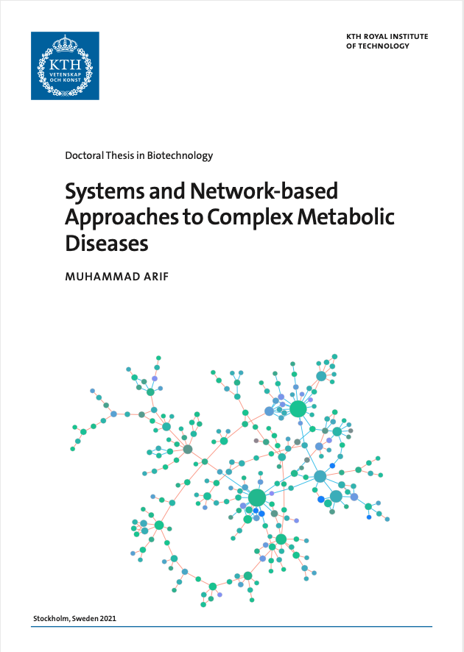

Introduction
Muhammad Arif
Indonesia
Postdoctoral Visiting Fellow
Section on Fibrotic Disorders
Laboratory of Cardiovascular Physiology & Tissue Injury
PhD in Systems Biology
KTH Royal Institute of Technology
Stockholm, Sweden
Interest:
Network Biology
Machine Learning
Translational Research
https://muharif.net

Slide 3
Systems Biology

Slide 4
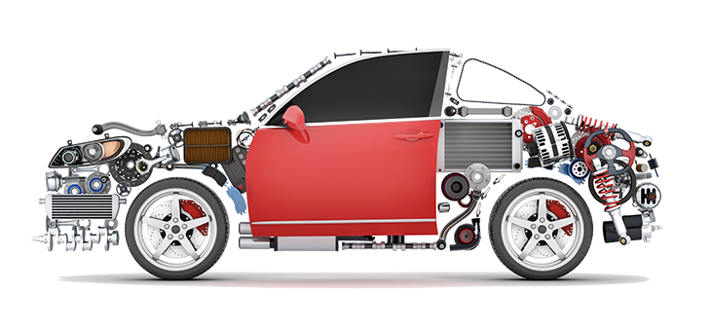
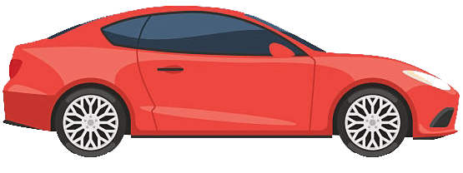
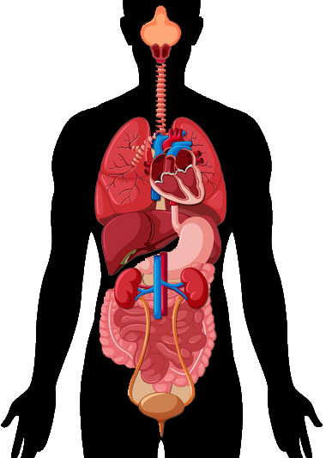
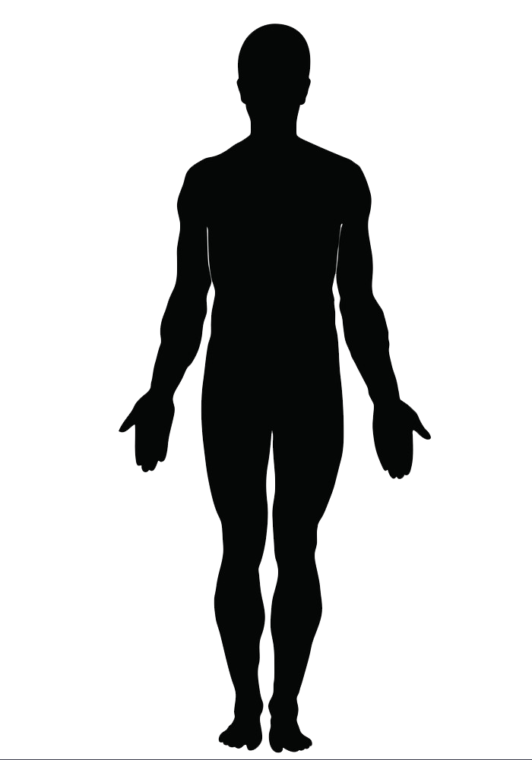
Human Body == Car
Need energy to be able to perform activities
Chemical → Kinetic
Complex System
Interconnected
Notes:
Human body is like a new state of the art car
CLICK
They both need energy to be able to perform properly
CLICK
The energy originated from chemical energy (from food and fuel) and converted to kinetic energy in order to move
But not only that, CLICK
both are complex systems with multiple parts
CLICK
that are interconnected to one another
Example:
The fuel pump in a car is related to their cooling system that are connected to electrical systems that are connected to lighting system.
Similarly in human body, everything is connected. The brain, lung, heart, liver, all are one big interconnected system

Slide 5
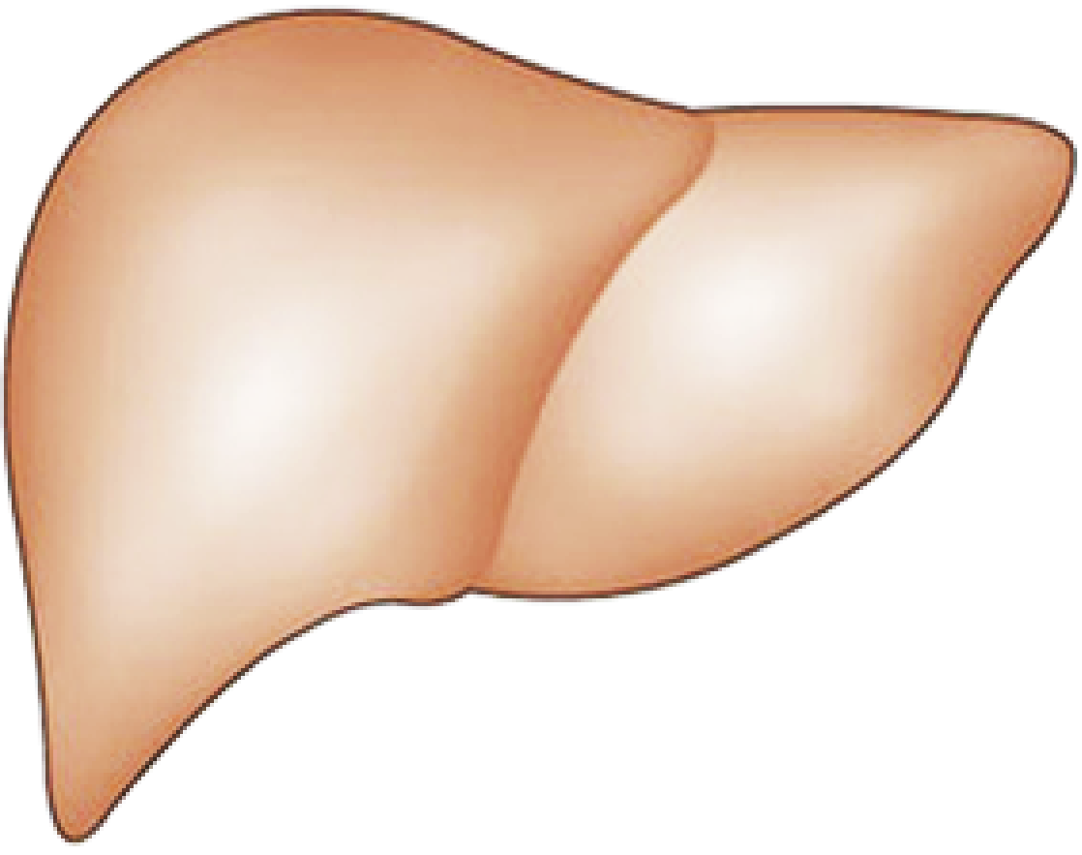
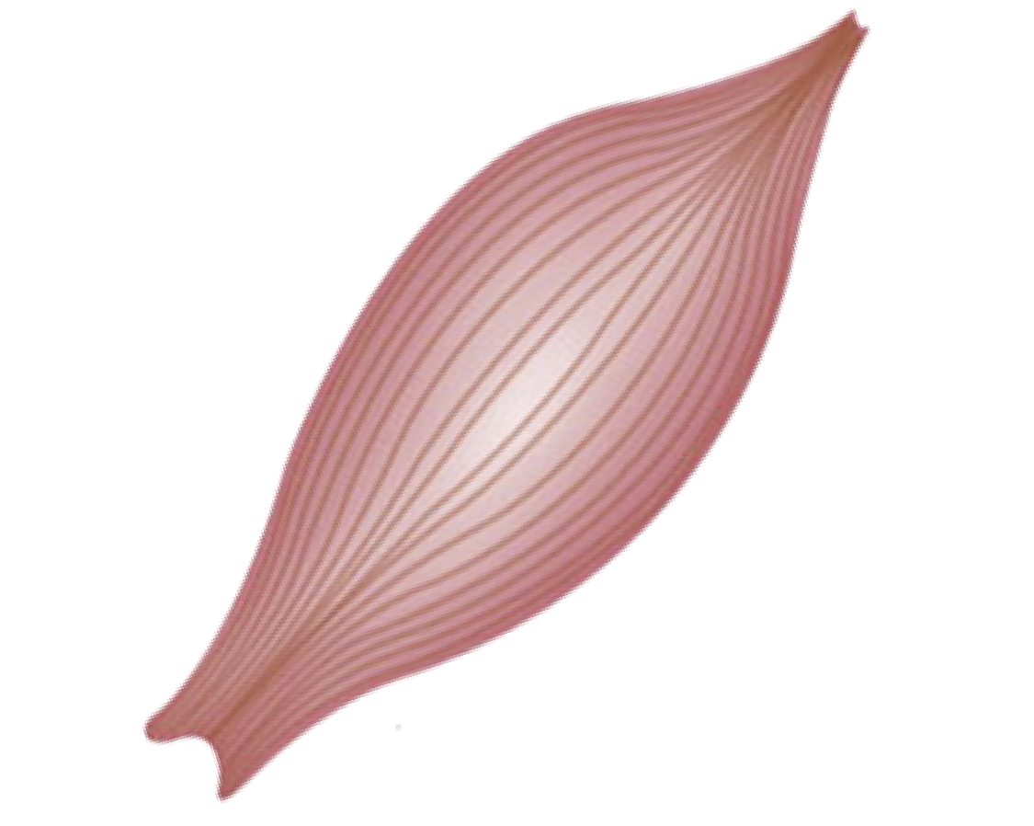
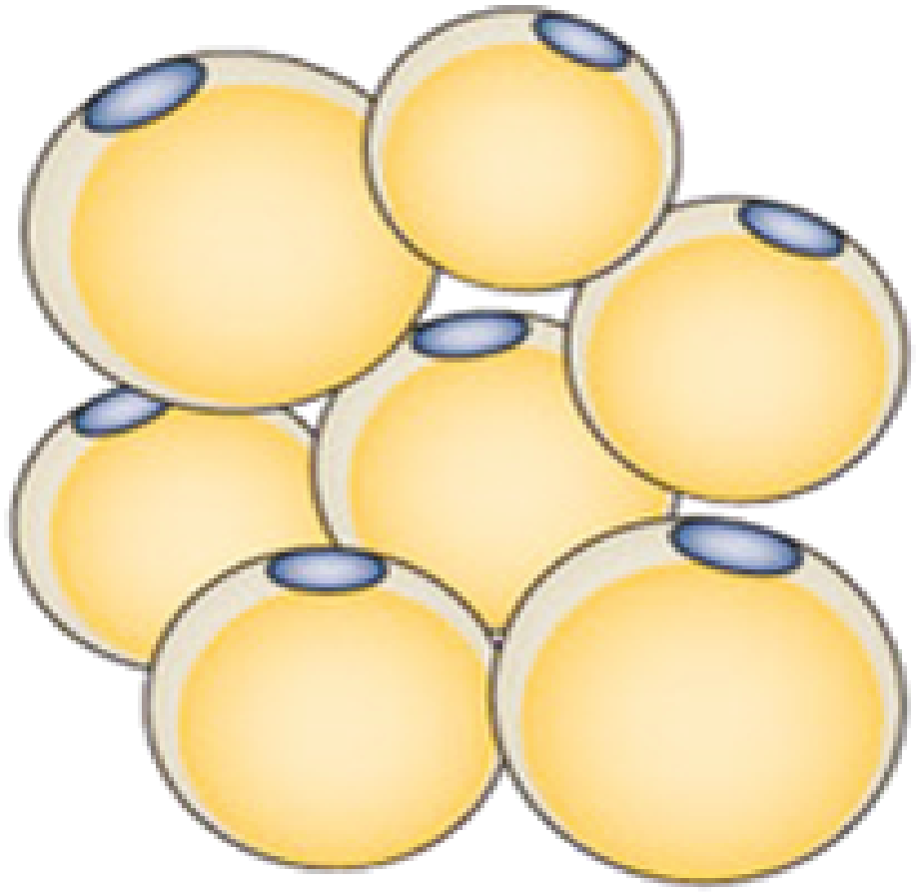
DNA
Genomics
Metabolites
Metabolomics
RNA
Transcriptomics
Microbiome
Metagenomics
Proteins
Proteomics
Notes:
When a car has electrical problem, it can be an isolated problem such as blinkers problem, but may also be central electrical problem that propagate to the entire car systems.
Similar with our body. For example,
CLICK
heart is very important organ in our body and
heart disease is a complex disease, most of the time, it has systemic effect to our body, so we cannot just focus on the heart only while treating it
We have to explore other important tissues too, such as
CLICK
Liver, Muscle, Adipose, and other important tissues to get better understanding of the disease
On top of tissue layers, there is another layer data, which is molecular data within the tissues or systems. One of the most superior molecular data is referred to as omics data, where it measures large number of analytes simultaneously.
omics data has been used and became huge helping hand for scientists in understanding diseases. There are many type of omics data, such as
CLICK CLICK CLICK

Slide 6
Systems Biology Paradigm
DNA
Genomics
Metabolites
Metabolomics
(Definition taken from Institute of Systems Biology)
Holistic approach to answer complex and important biological questions
Collaborative effort from multiple disciplines
Biology
Computer Science
Physics, etc
Predictive analysis to understand the condition changes
RNA
Transcriptomics
Microbiome
Metagenomics
Proteins
Proteomics
Notes:
We can leveraged these data to give us an interconnected and systematic view of human body.
But on the other hand, the complexity of the data is also increasing.
This emergence of complex and massive biological data
catalyzed by increasing computational power and the need of more efficient solution,
led to the emergence of a new multi-disciplinary paradigm and field in biology: Systems biology
CLICK
What is systems biology? CLICK
It's a holistic approach to answer complex and biological questions CLICK
As I said, it is a multidisciplinary field CLICK
And lastly, it has predictive characteristic to understand the condition changes CLICK

Slide 7
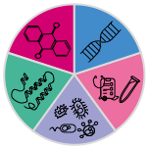
Approaches in Systems Biology
Statistical Inference
Altered analytes
Functional Analysis
Omics Data
Machine Learning
Patient characterization
Disease mechanism
Novel biomarkers
Novel Therapy
Drug Repositioning
Classification
Regression
Clustering
Network Analysis
Relationships
Centrality
Community
Notes:
There are many approaches in systems biology, but in this thesis we grouped them into 3 main approaches
CLICK
Originated from massive molecular omics data CLICK
The first approach is a more conventional approach or generally referred as frequentist approach --> Statistical inference to compare two or more datasets from different perturbation
CLICK It is generally used to find altered analytes and subsequently to be used in functional analysis
CLICK The second approach is using machine learning approaches to perform CLICK classification, regression, and or clusteing using data from different conditions
And finally, the third Approach is CLICK network analysis, that is the main focus of this thesis. CLICK
It is usually used to get relationships between different analytes, finding most important nodes (centrality analysis), and partitioning the data to disentangle the complexity (community analysis)
All this approaches have common goals, CLICK
I would like to say that In this presentation, I will be focusing only on the use of network analysis, even though we used the other approaches in our projects too.

Slide 8
Summer Projects

Slide 9
Summer Projects
Systems Biology of Pulmonary Fibrosis
Transcriptomics Data Analysis
Specifically:
Angelina: non-coding RNA-sequencing data analysis of Idiopathic Pulmonary Fibrosis (IPF)
Ben: protein-coding RNA-sequencing data analysis of Hermansky-Pudlak Syndrome Pulmonary Fibrosis (HPS PF)
Similar workflow, different target → you can work together
We will not learn how to program, but we will learn about the application of programming
Learning to code in R will be part of the curriculum, but not the main goal

Slide 10
Objectives
Exploring the gene expression changes in lung caused by pulmonary fibrosis
Identify important driver genes of the pulmonary fibrosis
Identify the affected/altered biological functions by the diseases
Specific goals:
Angelina: Analyze the relationship of non-coding RNA with endocannabinoid system genes
Ben: analyze the role of endocannabinoid system in the disease

Slide 11
Timeline
Week 2 (13-17 June): Pulmonary Fibrosis + Github Introduction
Week 3: Transcriptomics + R Introduction
Week 4: Statistical Analysis + Preparation for Research Presentation
Week 5: Functional Analysis + Research Presentation
Week 6: Co-Expression (Correlation) Network
Week 7: Contextualizing the results + Data Visualization
Week 8: Literature Review + Poster Preparation
Week 9: Poster Presentation
Each week: reading 1-2 articles + hands-on practice/application

Slide 12
Weekly Meeting
Every Friday at 2-4pm (Eastern Time)/11am-1pm (Pacific Time)
Agenda (Flexible):
Paper Presentations (@ 10-15 mins)
Result Discussions (@ 10-15 mins)
New topic presentation + hands-on practice
Planning for the next week
Friday (June 17th) meeting is moved to Tuesday (June 21st) at 3.30pm (Eastern Time)/12.30pm (Pacific Time)

Slide 13
Other Interactions
Email at anytime:
Expect a reply within 1 working day
Emergency only:
Text message is preferred
Do not call between 8pm-8am
Need an extra meeting (for q&a or discuss any other problems)? I’m open at anytime!
Email me and I will schedule ASAP, give 2-3 options of your time availability
Academic/Career Suggestion? Happy to provide!
Reference Letter? YES! Unlimited, at anytime (even in 10 years)
T&C: As long as you completed the internship
My website (muharif.net) will always have my most updated email address

Slide 14
Plan for 13-17 June 2022
Settle down and get excited ☺
Install:
R-Studio
GitHub
Read: Review papers about the diseases’ pathology and treatment and systems biology
Read it thoroughly
Summarize → Use this as the starting point of your presentation/poster
Gather as much info as possible
Do: GitHub Introduction (Find out why this is important)
https://summer2022.muharif.net/

Slide 15
Suggestions
Make notes when reading: (Do not just highlight the papers)
Offline: with notebook
Digital: Google Docs, Notion, Microsoft OneNote, Microsoft Word, Github Markdown, Evernote
Make “cheatsheets” for methods:
Offline: mindmap/flowchart on paper
Digital: Bubbl.us, MindMup, Visio, Microsoft PowerPoint
Remember: you are learning something new, do not give up just because you think “it’s too hard”. I’m here to guide you.
Try to learn as much as possible: Ask questions, join any training/seminar that are relevant
Observe how people are presenting scientific findings
Learn the jargons
After each analysis/article: check back to your report (poster/ppt) and think where it can fit to your story
Want to do extra analysis? Let me know, we will figure out how.

